Slide 1

one-to-one Relationship
Infoway Technologies, 3rd Floor Commerce Centre, Rambaug Colony, Paud Road Pune 411038

Slide 2
one-to-one Relationship
A one-to-one relationship between two tables means that a row in one table can only relate to one row in the table on the other side of their relationship and vice versa. This is the least common database relationship.
Infoway Technologies, 3rd Floor Commerce Centre, Rambaug Colony, Paud Road Pune 411038

Slide 3
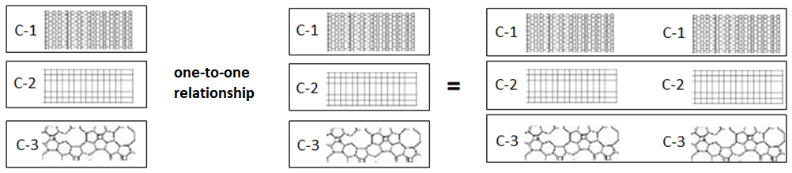
one-to-one relationship
A one-to-one relationship is a type of cardinality that refers to the relationship between two entities A and B in which one element of entity A may only be linked to one element of entity B, and vice versa.
Infoway Technologies, 3rd Floor Commerce Centre, Rambaug Colony, Paud Road Pune 411038

Slide 4
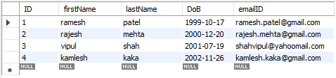
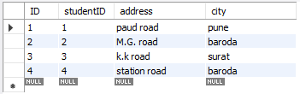

one-to-one relationship
CREATE TABLE student (
ID INT(11) PRIMARY KEY,
firstName VARCHAR(45),
lastName VARCHAR(45),
DoB DATE,
emailID VARCHAR(145)
);
CREATE TABLE student_address (
ID INT(11) PRIMARY KEY,
studentID INT UNIQUE NOT NULL,
address VARCHAR(45),
city VARCHAR(45) ,
FOREIGN KEY (studentID) REFERENCES student(ID)
);
Infoway Technologies, 3rd Floor Commerce Centre, Rambaug Colony, Paud Road Pune 411038

Slide 5
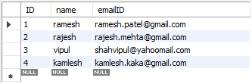
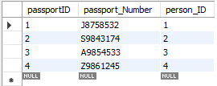

one-to-one relationship
CREATE TABLE person (
ID INT PRIMARY KEY ,
name VARCHAR(45),
emailID VARCHAR(128)
);
CREATE TABLE passportDetails (
passportID INT PRIMARY KEY,
passport_Number VARCHAR(255),
person_ID INT UNIQUE,
FOREIGN KEY (person_ID) REFERENCES person(ID)
);
Infoway Technologies, 3rd Floor Commerce Centre, Rambaug Colony, Paud Road Pune 411038

